Slide 1
Database and RDBMS Options
Databases are all about structuring data
As you've seen, databases are all about structuring data
Organizations structure the information they work with:
So that critical company information is stored for long periods of time
So that data can be persisted and worked with easily
So that they can find what they need, when they need it quickly and efficiently
To facilitate evaluation, comparison, and analysis
How data is structured is important and since that's the case, choosing the right database is critical to an organization's data-scalability needs

Slide 2
Database and RDBMS Options
The database structure you select generally influences…
The kinds of information you collect
How it’s possible to interrogate your data
The extent to which you can take advantage of your computer’s data-handling abilities
How easy it is to share data with others

Slide 3
Database and RDBMS Options
Database options
Tabular Data
Spreadsheets like Microsoft Excel, Google Sheets, Apache OpenOffice Calc, etc.
Traditional Relational Databases
Microsoft Access, Microsoft SQL Server, FileMaker Pro, MySQL, PostgreSQL, Oracle, IBM DB2, Sybase, SQLite, etc.
Non-Tabular Data
Document-orientated databases (MongoDB, CouchDB, Couchbase, Terrastore, RavenDB, OrientDB, ThruDB, SisoDB, RaptorDB, CloudKit, Jackrabbit, etc.), RDF Triplestores (linked data on the Web), qualitative data analysis packages (NVivo and ATLAS.ti), etc.

Slide 4
Database and RDBMS Options
When to use a relational database
Some data is inherently better suited to a relational database which can host several databases on one server. Other advantages include:
Ease of Use: The use of tables to store data in columns and rows makes it easy to access and manage data.
Data Security: With an RDBMS you can hide sensitive tables and give them their authorization codes, providing a layer of protection for your data
SQL Standard: SQL is a standardized language well understood by many applications, and many of the alternative database options provide SQL interfaces.
Data Integrity: The structure of the relational database preserves the integrity of the data and makes it easier to meet compliance regulations.
Performance: An RDBMS uses indexes to sort data and speed up performance, and supports both desktop and web applications.
Development and Support: The large players like Oracle, Microsoft, SAP, etc. all have a vested interest in continuing to develop and evolve their database offering to meet modern standards. Support is guaranteed for years to come.

Slide 5
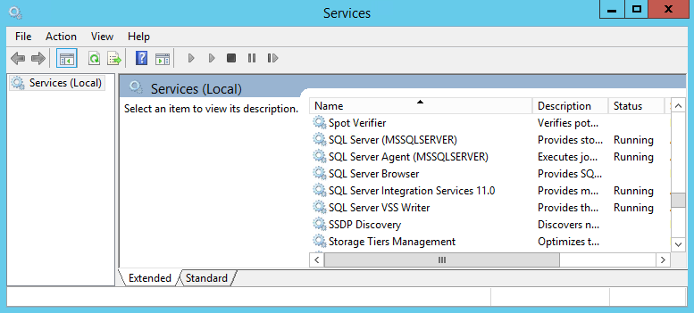
Database and RDBMS Options
The parts of a relational database system
Most large-scale database solutions are complex systems that can require dedicated resources (hardware, software, and manpower) in order maintain properly. Enterprise solutions like Microsoft's SQL Server exist in large ecosystems and are typically broken down into the following tiers:
The Database The actual database and its attendant storage structure.
The Engine Interprets requests between the database and the application. On a Windows server, the engine typically runs silently in the background as a service.
The Application The part the user sees and uses.

